Slide 1
COPYRIGHT VS COPYLEFT
By Nimisha (BCA)

Slide 2


INTRODUCTION
USER SPACE
e.g. document etc.
RESOURCE

Slide 3

What is
?
A copyright is a formal declaration that the owner is the only one with the right to publish, reproduce, or sell a particular artistic work. The protection of a copyright is granted by the government, and covers original literary (writings), dramatic (stage and film) musical, artistic, and other creations.
For example, assume you bought a DVD of Star Wars – A New Hope, you can use this DVD according to specific rules as defined on the package like playing it at your home with your friends.
You cannot do anything with it that is not allowed by the publisher like copying the DVD and give a copy to your friend. This is because the publisher has the copyright of the movie and will probably use you if they know you are copying the DVD.

Slide 4



Symbols of copyright

Slide 5


What is
?
Copyleft is a general method for making a program free software and requiring all modified and extended versions of the program to be free software as well. The simplest way to make a program free is to put it in the public domain, uncopyrighted. This allows people to share the program and their improvements if they are so minded.
For example, Free-software licenses that use “weak” copyleft include the GNU Lesser General Public License and the Mozilla Public License. Examples of non-copyleft (“permissive”) free-software licenses include the X11 license, Apache license, and the BSD licenses.

Slide 6


Symbols of copyleft:

Slide 7
Difference between Copyright and Copyleft in FOSS:
S.No. | Copyright | Copyleft
1. | Copyright is the right that enable you to prevent unauthorized copying or selling of your work. | Whereas Copyleft is a method using which you can modify the software or documentation and distribute it back to the open-source community.
2. | In Copyright the work is original and not the copy of other. | On the other hand Copyleft comes with an idea of collaboration.
3. | Copyrights protects you original ideas from others access. | While Copyleft allows you to make changes to other ideas and give them back.
4. | Copyright is all about granting individual permission. | Copyleft is all about user freedom.

Slide 8
S.No. | Copyright | Copyleft
5. | You can apply Copyright protection both to work that you have published into the public domain and work that you have not published. | While Copyleft allows users to distribute derivative works under a license that offers the same rights as the original work.
6. | Examples of Copyright: Suppose you made a movie, now if anyone else wants to make its sequel, he has to buy copyright from you. | Examples of Copyleft: Red Hat Enterprise Linux is a good practical example of copyleft. Which is a commercial operating system. Users are free to modify and redistribute the source code but they are not allowed to resell it.
7. | It is denoted by © | It is denoted by mirror image of copyright symbol.

Slide 9

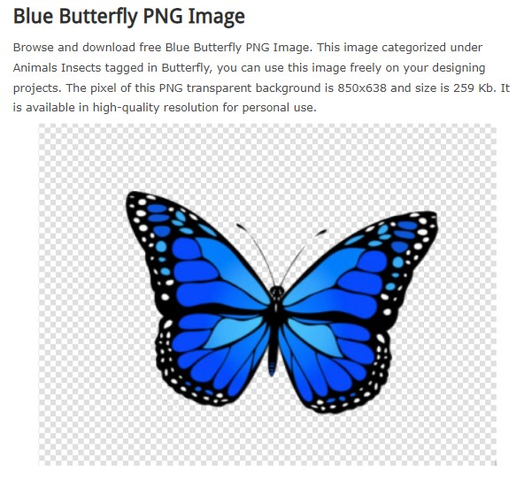
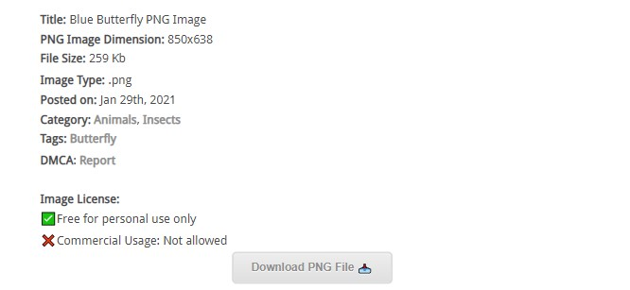
Respect the author

Slide 10


